Slide 1
Blockchain in research & education
Martin Hamilton

Slide 2
Blockchain in research & education
Blockchain’s Bitcoin origins
Libertarians and Wall Street get into bed together
Using blockchain in research & education
Rounding up some potential use cases
What’s next?

Slide 3
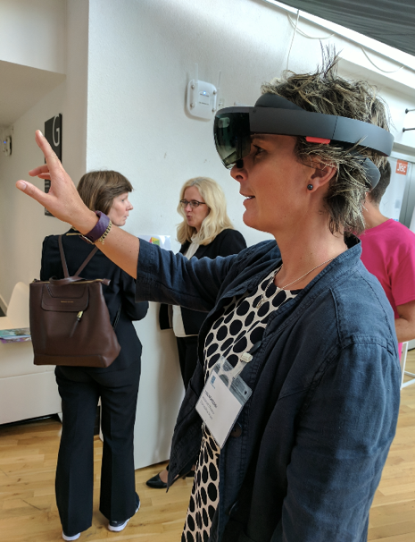
About Jisc
Not-for-profit company serving the HE, FE and skills community:
18 million users of shared services like Janet, eduroam, JiscMail, shared data centres
Devising national deals with IT vendors and publishers, e.g. Amazon, Google, Microsoft, Elsevier and Springer
Providing advice & guidance to the sector on digital technologies in research and education
My role:
Leading a small group exploring emerging technologies like Augmented Reality and brain computer interfaces
Helping institutions devise/implement digital strategies and building evidence base around new technologies
Notes:
And I used to run a supercomputing (HPC) centre in a former life.

Slide 4
About Jisc
Not-for-profit company serving the HE, FE and skills community:
18 million users of shared services like Janet, eduroam, JiscMail, shared data centres
Devising national deals with IT vendors and publishers, e.g. Amazon, Google, Microsoft, Elsevier and Springer
Providing advice & guidance to the sector on digital technologies in research and education
My role:
Leading a small group exploring emerging technologies like Augmented Reality and brain computer interfaces
Helping institutions devise/implement digital strategies and building evidence base around new technologies

Slide 5
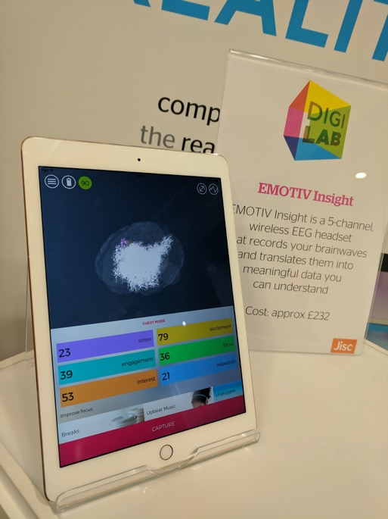
About Jisc
Not-for-profit company serving the HE, FE and skills community:
18 million users of shared services like Janet, eduroam, JiscMail, shared data centres
Devising national deals with IT vendors and publishers, e.g. Amazon, Google, Microsoft, Elsevier and Springer
Providing advice & guidance to the sector on digital technologies in research and education
My role:
Leading a small group exploring emerging technologies like Augmented Reality and brain computer interfaces
Helping institutions devise/implement digital strategies and building evidence base around new technologies

Slide 6
1. Blockchain’s Bitcoin origins

Slide 7
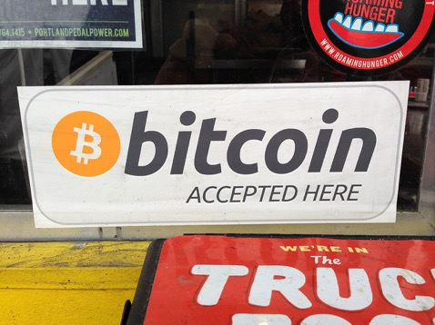
Blockchain’s Bitcoin origins
How we got here, part 1
2007: “Satoshi Nakamoto” allegedly begins development of the Bitcoin virtual currency
2009: Version 0.1 of Bitcoin is released on SourceForge, and the first transaction takes place
2010: Programmer buys pizza for 10,000BTC (now worth $39,454,600!)
2011: Silk Road “dark web” marketplace opens
2011: 25% of the 21 million possible Bitcoins now generated through mining operations
More at http://historyofbitcoin.org/
Photo CC BY-SA Flickr user fstorr

Slide 8
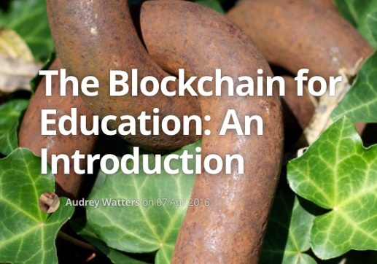
Blockchain’s Bitcoin origins
How we got here, part 2
Blockchain is the underlying distributed ledger technology that powers Bitcoin:
“The blockchain is a distributed database that provides an unalterable, (semi-)public record of digital transactions.
Each block aggregates a timestamped batch of transactions to be included in the ledger – or rather, in the blockchain.
Each block is identified by a cryptographic signature.
These blocks are all back-linked; that is, they refer to the signature of the previous block in the chain, and that chain can be traced all the way back to the very first block created.
As such, the blockchain contains an un-editable record of all the transactions made.”
From Audrey Watters / Hack Education: http://hackeducation.com/2016/04/07/blockchain-education-guide
From Audrey Watters / Hack Education
Notes:
For those who want to delve a little deeper - Google “Merkle Trees”

Slide 9
Blockchain’s Bitcoin origins
How we got here, part 2
Blockchain is the underlying distributed ledger technology that powers Bitcoin:
“The blockchain is a distributed database that provides an unalterable, (semi-)public record of digital transactions.
Each block aggregates a timestamped batch of transactions to be included in the ledger – or rather, in the blockchain.
Each block is identified by a cryptographic signature.
These blocks are all back-linked; that is, they refer to the signature of the previous block in the chain, and that chain can be traced all the way back to the very first block created.
As such, the blockchain contains an un-editable record of all the transactions made.”
From Audrey Watters / Hack Education: http://hackeducation.com/2016/04/07/blockchain-education-guide
From Audrey Watters / Hack Education

Slide 10
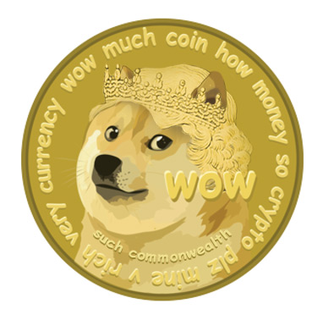
Blockchain’s Bitcoin origins
How we got here, part 3
Interest in virtual currencies (honourable mention for Dogecoin here) parlayed into platforms…
Ethereum’s programmable blockchain: “how to abstract decentralised transfer of value to a generalised state transition function, supporting any application” https://www.ethereum.org/
Namecoin’s decentralised naming: “Bitcoin frees money – Namecoin frees DNS, identities, and other technologies” https://namecoin.org/
Libertarian ideas embraced by Wall Street, government - e.g. UK’s blockchain welfare trial
Dogecoin logo CC BY-SA Flickr user flyingblogspot.
More Shiba Inu goodness at http://dogecoin.com/
Notes:
Side note: Dogecoin sponsored the Jamaican bobsled team to get to the Winter Olympics in Sochi in 2014

Slide 11
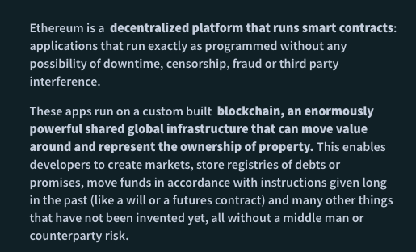
Blockchain’s Bitcoin origins
How we got here, part 3
Interest in virtual currencies (honourable mention for Dogecoin here) parlayed into platforms…
Ethereum’s programmable blockchain: “how to abstract decentralised transfer of value to a generalised state transition function, supporting any application” https://www.ethereum.org/
Namecoin’s decentralised naming: “Bitcoin frees money – Namecoin frees DNS, identities, and other technologies” https://namecoin.org/
Libertarian ideas embraced by Wall Street, government - e.g. UK’s blockchain welfare trial
Dogecoin logo CC BY-SA Flickr user flyingblogspot.
More Shiba Inu goodness at http://dogecoin.com/
Notes:
Side note: Dogecoin sponsored the Jamaican bobsled team to get to the Winter Olympics in Sochi in 2014

Slide 12
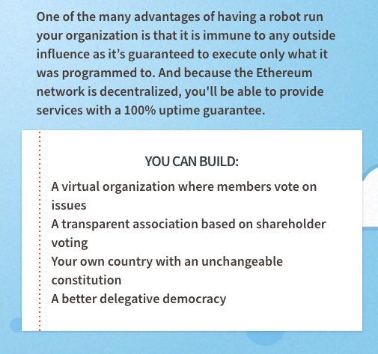
Blockchain’s Bitcoin origins
How we got here, part 3
Interest in virtual currencies (honourable mention for Dogecoin here) parlayed into platforms…
Ethereum’s programmable blockchain: “how to abstract decentralised transfer of value to a generalised state transition function, supporting any application” https://www.ethereum.org/
Namecoin’s decentralised naming: “Bitcoin frees money – Namecoin frees DNS, identities, and other technologies” https://namecoin.org/
Libertarian ideas embraced by Wall Street, government - e.g. UK’s blockchain welfare trial
Dogecoin logo CC BY-SA Flickr user flyingblogspot.
More Shiba Inu goodness at http://dogecoin.com/
Notes:
Side note: Dogecoin sponsored the Jamaican bobsled team to get to the Winter Olympics in Sochi in 2014

Slide 13
2. Using blockchain in research & education

Slide 14
Blockchain in research & education
Credentialling
e.g. Blockcerts from MIT et al - “Build apps that issue and verify blockchain-based certificates for academic credentials, professional certifications, workforce development, and civic records” https://www.blockcerts.org
Is Martin really a medical doctor? Should I let him perform brain surgery on me? (apparently he qualified in Nambia…)
Martin wants to transfer course to another university and take his academic credit with him
Martin has been doing a work placement and his employer has some feedback to add
Martin has lost his A Level / degree certificates…
Blockcerts activity flow - from blockcerts.org
Notes:
Also consider the transition from primary to secondary education, then to school, college, workplace CPD

Slide 15
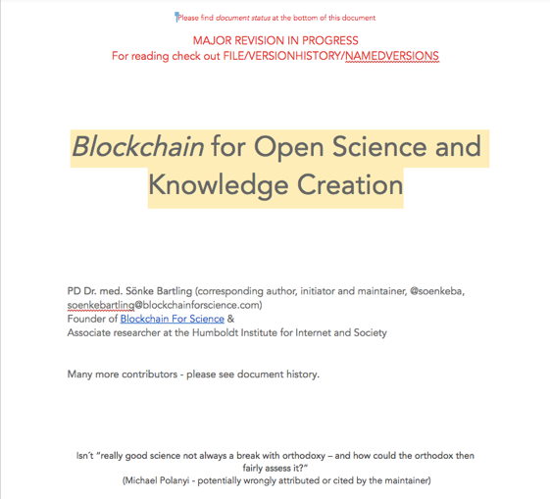
Blockchain in research & education
Research provenance and reproducibility
Blockchain could “reduce overhead and accelerate the scientific process”, from http://www.blockchainforscience.com/
Where is the code and data linked to Martin’s paper? (maybe stored on IPFS?)
Who has cited Martin’s paper / code / data?
Who has re-used Martin’s code and data?
What grants has Martin brought in?
What collaborators and what equipment has Martin been working with?
Has Martin published in enough prestigious journals to get a bonus / tenure?
Blockchain for Open Science and Knowledge Creation -
living document from http://www.blockchainforscience.com/

Slide 16
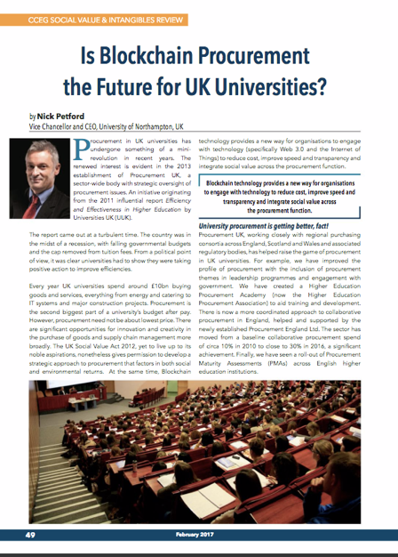
Blockchain in research & education
Efficiency, effectiveness and social value
“Blockchain provides a new way for organisations to engage with technology to reduce cost, improve speed and transparency and integrate social value” - Nick Petford, University of Northampton VC & CEO
Martin’s student loan is automatically approved and tuition fees paid on confirmation of his place
Martin’s institution tracks provenance of goods and services, e.g. https://www.provenance.org
Martin’s library fine is automatically deducted from his eduCoin account
Martin decides to switch to a course at another institution - credit transfer takes place automatically
Social Value and Intangibles Review - February 2017
Notes:
There was a startup called eduCoin…

Slide 17
Blockchain in research & education
Your questions and potential use cases
Blockchain for CPD & Accreditation
Records management
What/How should library prepare to start using blockchain applications? (e.g. IT infrastructure, knowledge)
Blockchain for financial transactions, peer review, data management
Transaction time and cost for ledger entries
Photo CC BY-NC-ND Flickr user rinux
Notes:
There was a startup called eduCoin…

Slide 18
3. What’s next?

Slide 19
What’s next?
Avoiding the pointless blockchain project
From Coin Sciences CEO Gideon Greenspan:
Must be a database
Must have multiple writers / updaters
You don’t trust the folk updating the database
You don’t need a trusted intermediary to vouch for updates / updaters
Transactions are often dependent on each other
Database contains rules for assessing the legitimacy of transactions
Database contains a mechanism for conflict resolution
Information / asset in database can be drawn down, e.g. funds transfer
https://www.multichain.com/blog/2015/11/avoiding-pointless-blockchain-project/

Slide 20
What’s next?
How we got here, part 2 (reminder!)
Blockchain is the underlying distributed ledger technology that powers Bitcoin:
“The blockchain is a distributed database that provides an unalterable, (semi-)public record of digital transactions.
Each block aggregates a timestamped batch of transactions to be included in the ledger – or rather, in the blockchain.
Each block is identified by a cryptographic signature.
These blocks are all back-linked; that is, they refer to the signature of the previous block in the chain, and that chain can be traced all the way back to the very first block created.
As such, the blockchain contains an un-editable record of all the transactions made.”
From Audrey Watters / Hack Education: http://hackeducation.com/2016/04/07/blockchain-education-guide
From Audrey Watters / Hack Education

Slide 21
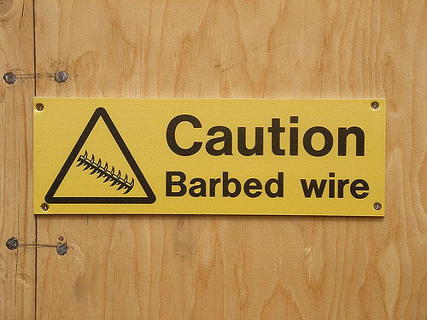
What’s next?
Some issues
Public/private? cf. GDPR + initiatives like Sovrin self-sovereign identities https://sovrin.org
Immutable? See Accenture’s “chameleon hash” work http://fortune.com/2016/09/20/accenture-blockchain/
Permissionless or permissioned?
Real data on the blockchain, or just a cryptographic hash (fingerprint) of the real data?
Proof of work versus proof of stake, aka “do I need to use vast amounts of compute time to mine virtual coins?”
Transaction speed and potential scaling issues
Hippies versus nerds ☺
Photo CC BY Flickr user arenamontanus
Notes:
Bitcoin currently achieving 3-4 transactions/second. PayPal handle around 200 transactions/second. Ethereum better at 20 transactions/second, but still a long way to go…

Slide 22
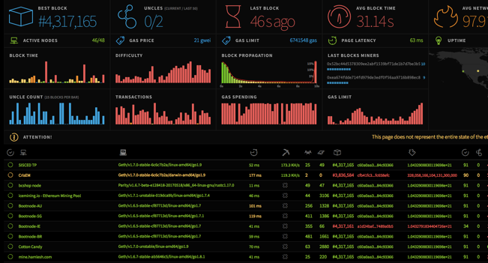
What’s next?
Conclusions
Lots of potentially transformational applications for blockchain / distributed ledgers in research and education
But… we are still at the “28k modem” stage, comparable with early web
Avoid the pointless blockchain project!
Potential collaborators are global as well as local
Lots of interesting presentations at the recent Blockchain in Education conference https://www.bcined2017.nl
Shout out for the OU’s Open Blockchain R&D - http://blockchain.open.ac.uk
Jisc horizon scanning report coming soon - see http://foresight.jiscinvolve.org
Ethereum network stats - from https://ethstats.net/

Slide 23
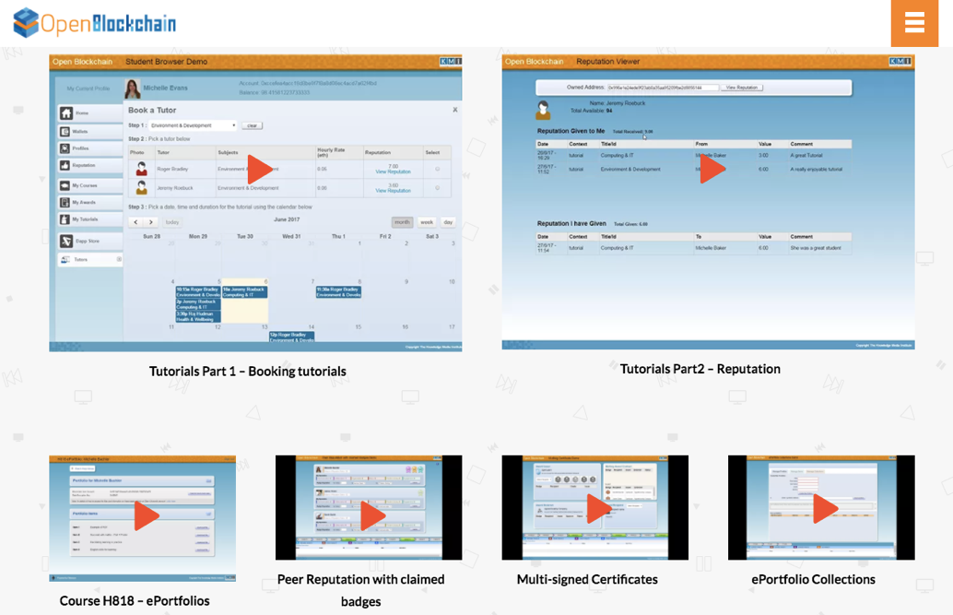
What’s next?
Conclusions
Lots of potentially transformational applications for blockchain / distributed ledgers in research and education
But… we are still at the “28k modem” stage, comparable with early web
Avoid the pointless blockchain project!
Potential collaborators are global as well as local
Lots of interesting presentations at the recent Blockchain in Education conference https://www.bcined2017.nl
Shout out for the OU’s Open Blockchain R&D - http://blockchain.open.ac.uk
Jisc horizon scanning report coming soon - see http://foresight.jiscinvolve.org
Ethereum network stats - from https://ethstats.net/

Slide 24
Continue the conversation…
Martin Hamilton
Futurist, Jisc
@martin_hamilton
martin.hamilton@jisc.ac.uk
Except where otherwise noted, this work is licensed under CC-BY

